Slide 1
Chapter 3
Memory and Memory Interfacing
Section 3.01 Semiconductor Memory Fundamentals
In the design of all computers, semiconductor memories are used as primary storage for code and data.
The main requirement of primary memory is that it must be fast in responding to CPU.
Memory capacity
Computer: byte
Memory: bit

Slide 2
Memory Organization
Each memory chip contains 2^{x} locations, where x is the number of address pins on the chip
Each location contains y bits, where y is the number of data pins on the chip.
The entire chip will contain 2^{x}×y bits.
Speed
One of the most important characteristics of a memory chip is the speed at which data can be accessed from it.
The speed of the memory chip is commonly refer to as its access time.

Slide 3
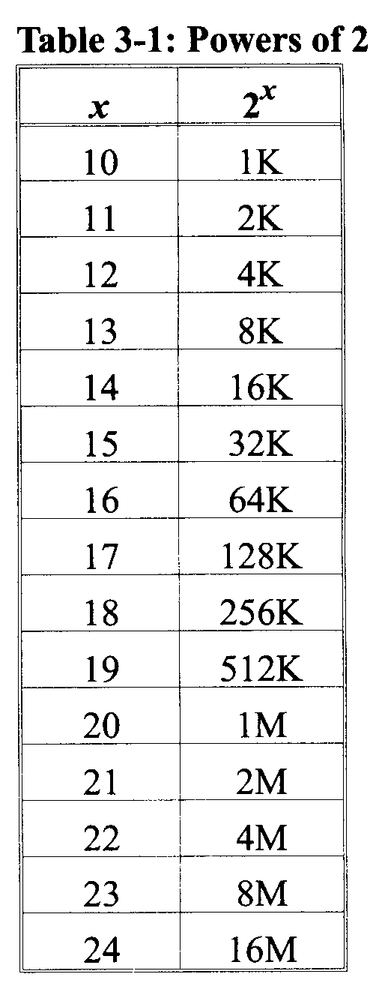

Slide 4
ROM (read-only memory)
ROM is the type of memory that does not lose its contents when the power is turned off.
nonvolatile memory
PROM (programmable ROM)
PROM refers to the kind of ROM that the user can burn information into.
User-programmable memory
For every bit of the PROM, there exists a fuse.
OTP (one-time programmable)
Table 3-2 shows examples of some popular ROM chips and their characteristics.

Slide 5
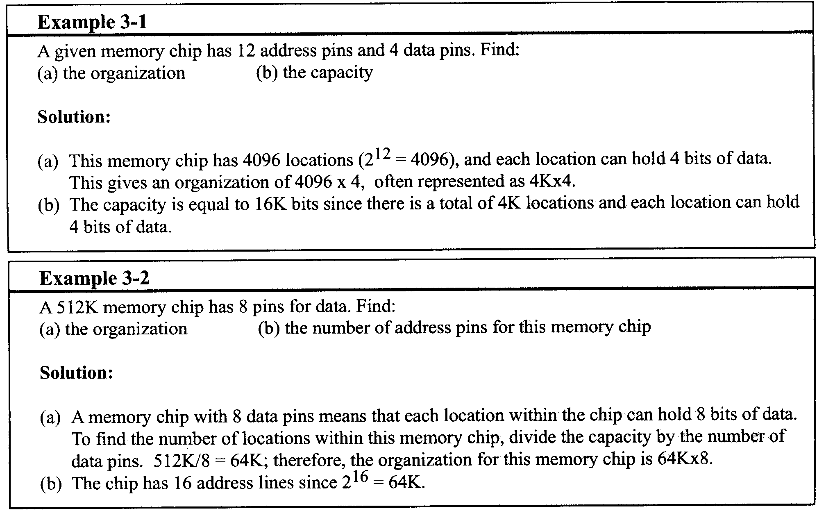

Slide 6
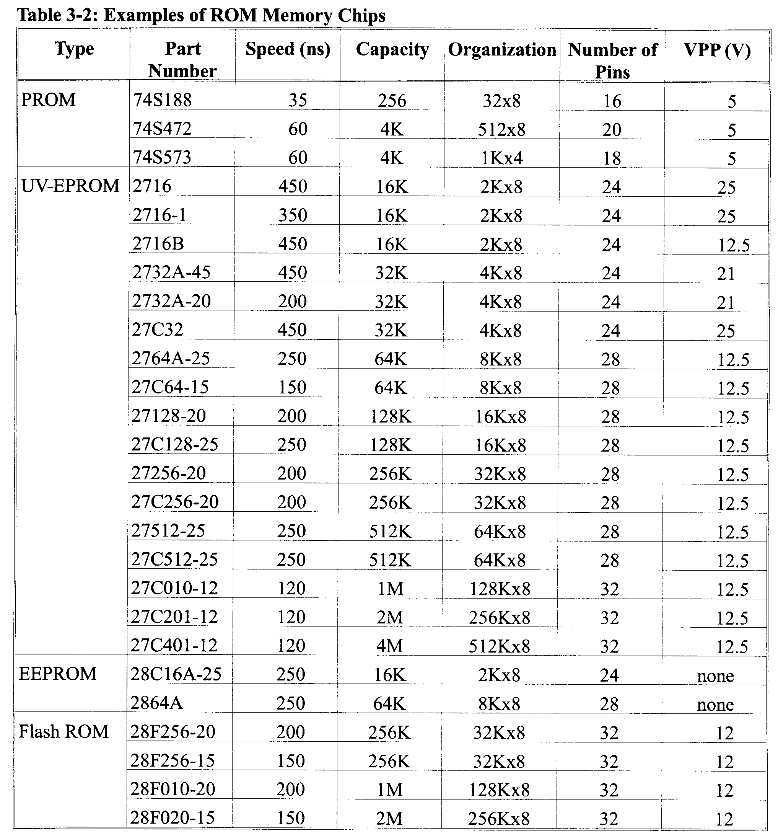

Slide 7
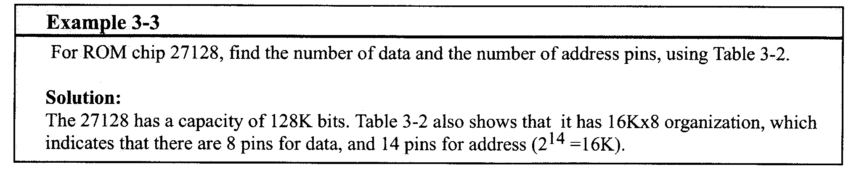
EPROM (erasable programmable ROM)
EPROM was invented to allow making changes in the contents of PROM after it is burned
In EPROM, one can program the memory chip and erase it thousands of times.
All EPROM chips have a window that is used to shine ultraviolet (UV) radiation to erase its contents.

Slide 8
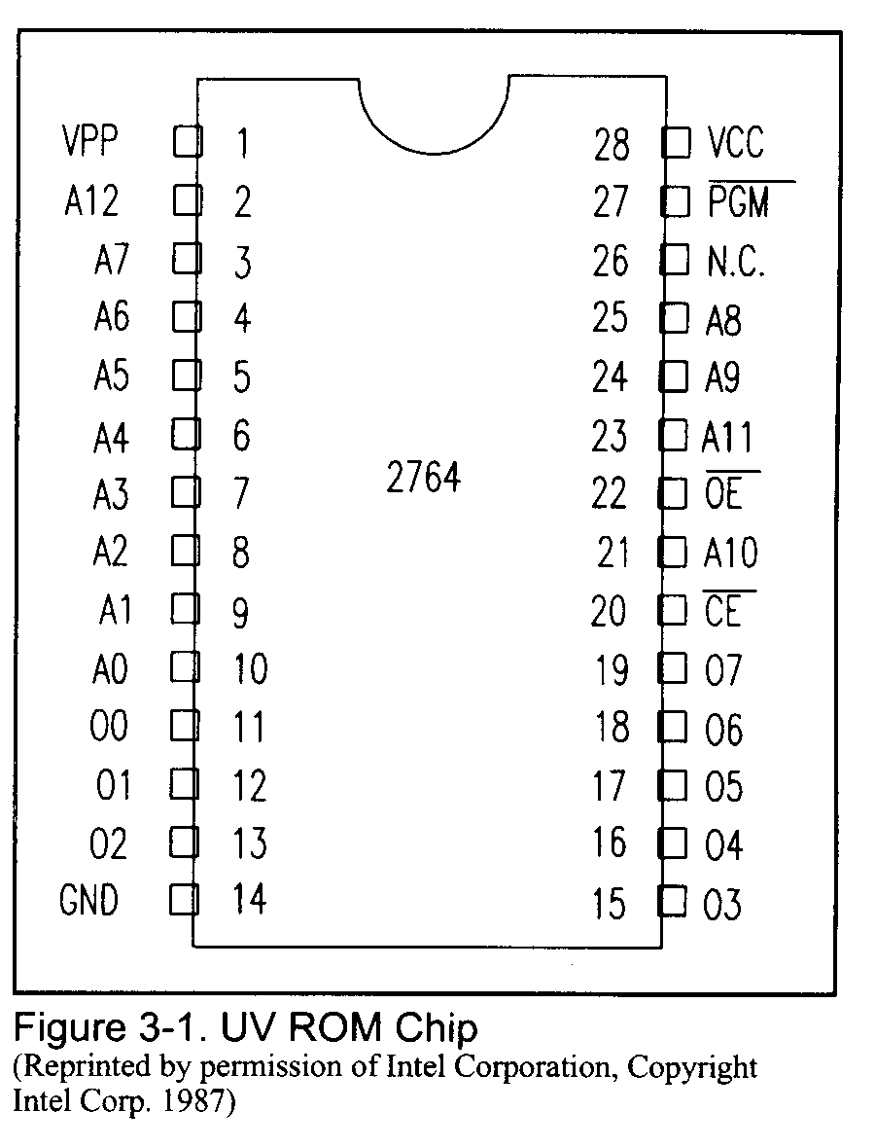

Slide 9
To program a UV-EPROM chip:
Its contents must be erased.
Program the chip
Place the chip back into its socket on the system board.
Disadvantage of UV-EPROM is that it cannot be programmed while in the system board.
EEPROM (electrically erasable programmable ROM)
Erase instantly
Can select erased byte
Program and erase its contents while it is still in the system board.

Slide 10
Flash memory EPROM
Since the early 1990s, flash EPROM has become a popular user-programmable memory chip.
The process of erasure of the entire contents takes less than a second, or one might say in a flash, hence its name: flash memory.
The major difference between EEPROM and flash memory is the fact that when flash memory’s contents are erased the entire device is erased, in contrast to EEPROM, where one can erase a desired section of byte.
blocks
Mask ROM
Whose contents are programmed by the IC manufacturer, it is not a user-programmable ROM.

Slide 11
RAM (random access memory)
RAM memory is called volatile memory
Static RAM (SRAM)
Dynamic RAM (DRAM)
NV-RAM (nonvolatile RAM)
SRAM
Storage cells in static RAM memory are made of flip-flops and therefore do not require refreshing in order to keep their data.
at least 6 transistors to build
used for cache memory

Slide 12
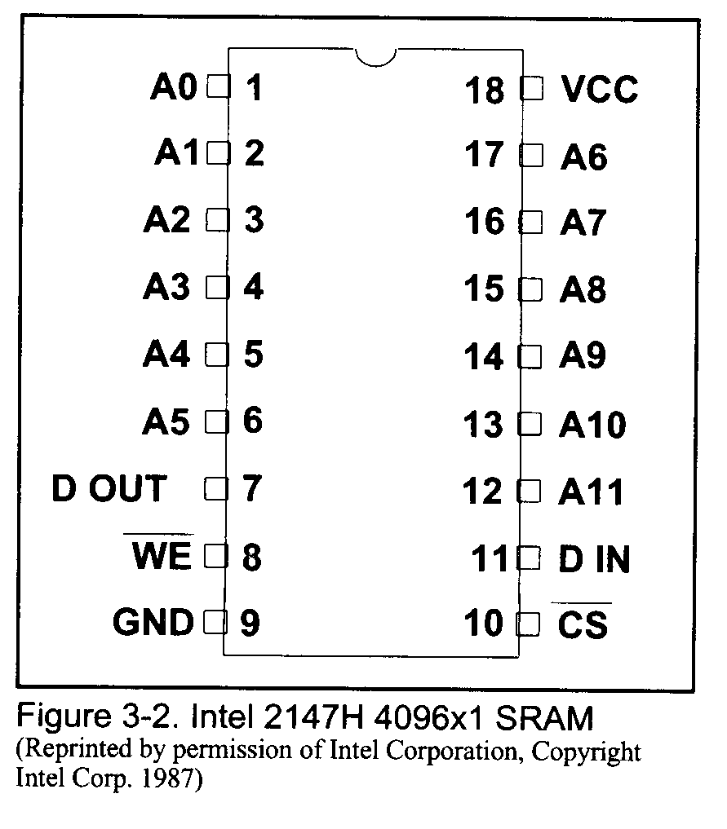

Slide 13
DRAM
Since the early days of the computer, the need for huge, inexpensive read/write memory was a major preoccupation of computer designers.
In 1970, Intel Corporation introduced the first dynamic RAM (DRAM).
It used a capacitor to store each bit.
It requires refreshing.
The major advantages are high density (capacity), cheaper cost per bit, and low power consumption per bit.
The disadvantage is that it must be refreshed periodically.
Since 1970 the capacity of DRAM has exploded.

Slide 14
Packaging Issue in DRAM
To reduce the number of pins needed for address, multiplexing/ demultiplexing is used.
To split the address into half and send in each half of the address through the same pins
The first half of the address is called the raw and the second half is called the column.
RAS (row address strobe)
CAS (column address strobe)
DRAM controller
DRAM organization
DRAM can have any of ×1, ×4, ×8, or ×16 organizations
Most DRAMs are ×1 and ×4.

Slide 15
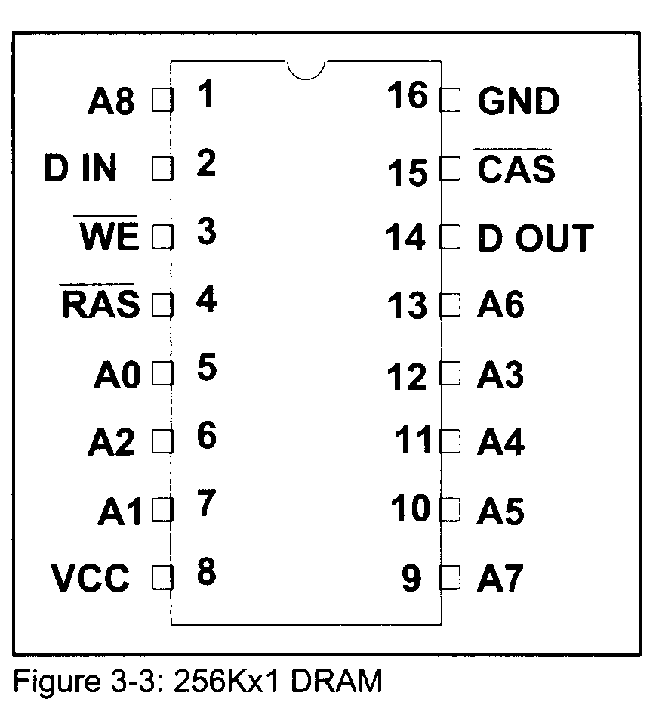

Slide 16
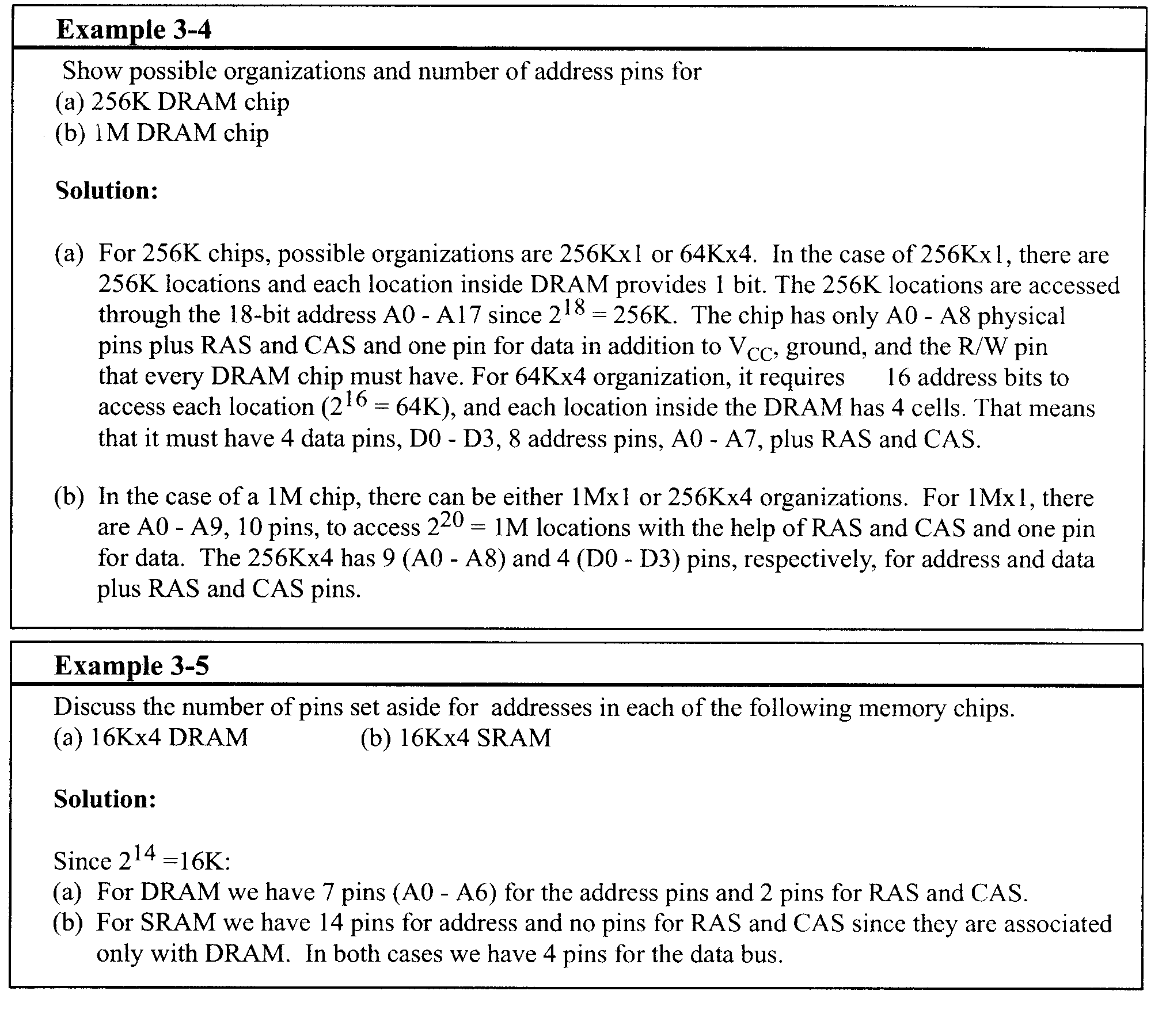

Slide 17
NV-RAM (nonvolatile RAM)
NV-RAM combines the best of RAM and ROM: the read and writablility of RAM, plus the novolatility.
It uses extremely power efficient (very very low power consumption) SRAM cells built out of CMOS.
It uses an internal lithium battery as a backup energy source.
It uses an intelligent control circuitry.

Slide 18
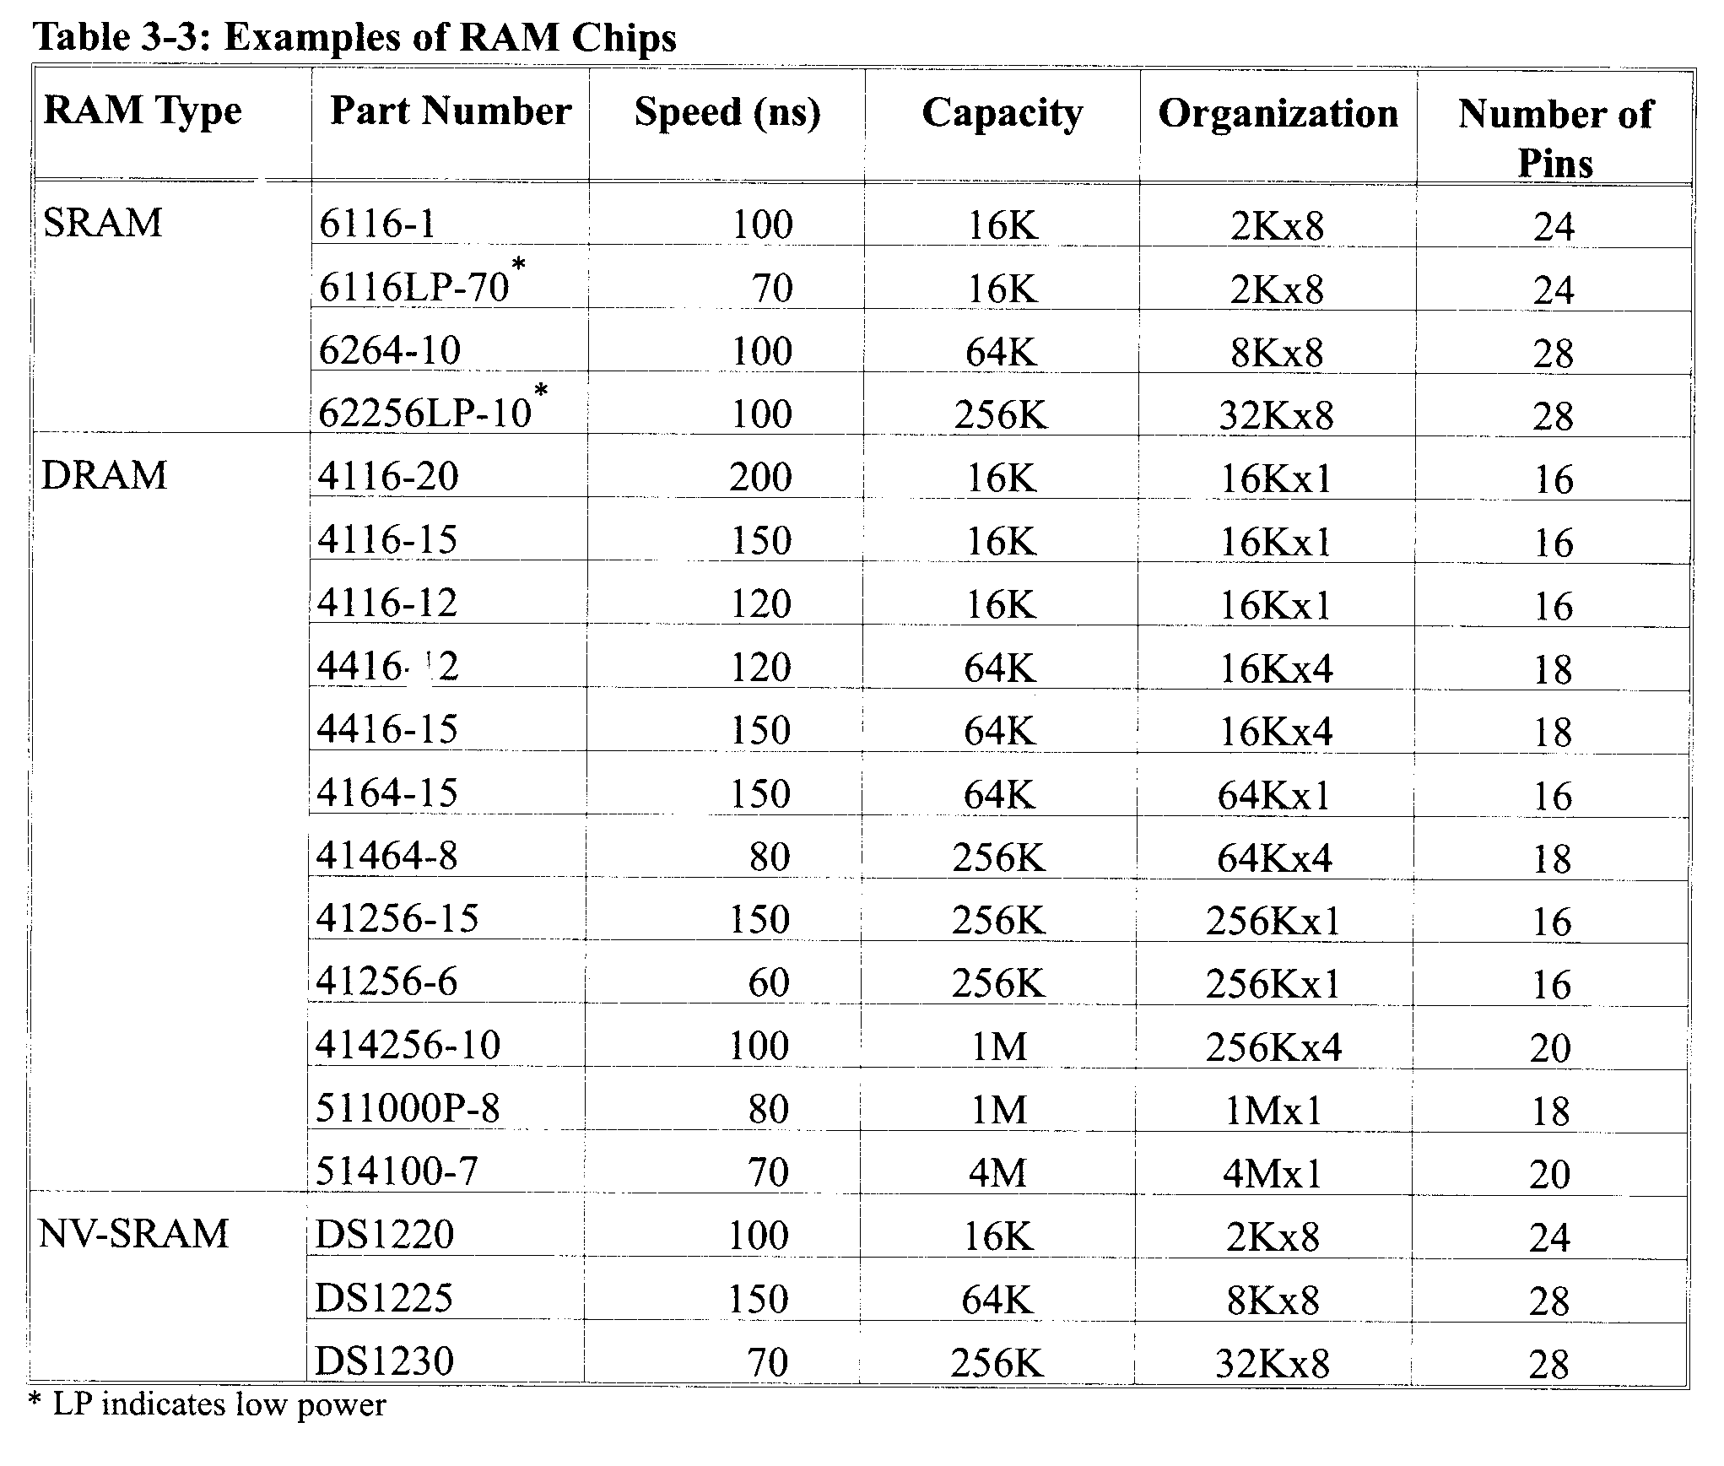

Slide 19
Methods of Address Decoding
The CPU provides the address of the data desired, but it is the job of the decoding circuitry to locate the data using the address bits provided by the CPU.
No data can be written into or read from the memory chip unless CS is activated.
Simple Logic Gate as Address Decoder
The simplest method of decoding circuitry is the use of NAND or other gates.
Fig. 3-4, which shows that A19-A14 = 000011 in order to select the chip. This results in the assignment of address 0C000H to 0FFFFH to this memory chip.

Slide 20
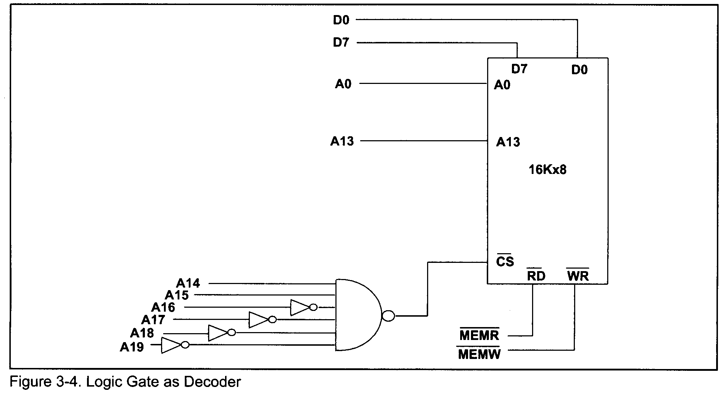

Slide 21
Using the 74xx138 3-8 Decoder
This is one of the most widely used address decoder
Y0-Y7
A, B, C
G2A, G2B, and G1
Using PAL16L8 as an Address Decoder
Another widely used decoder is the PAL16L8 chip.

Slide 22
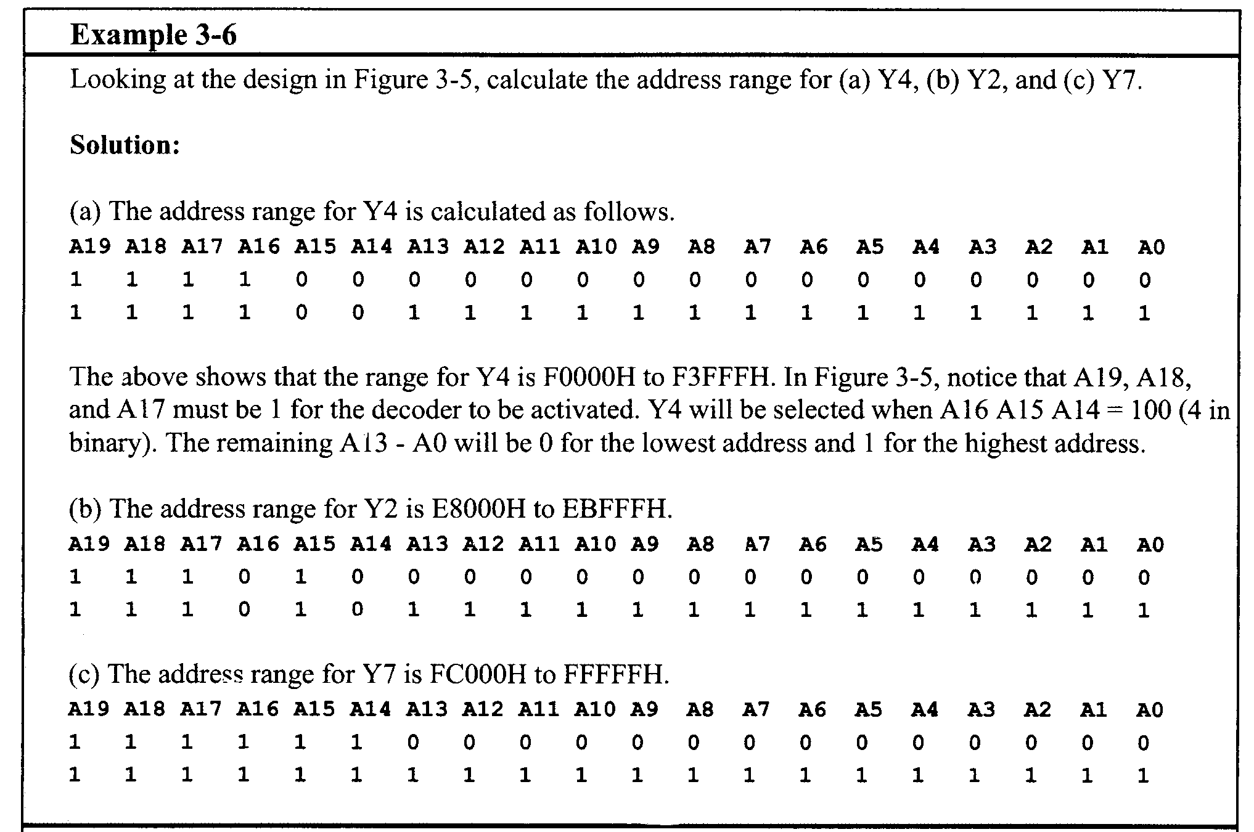

Slide 23
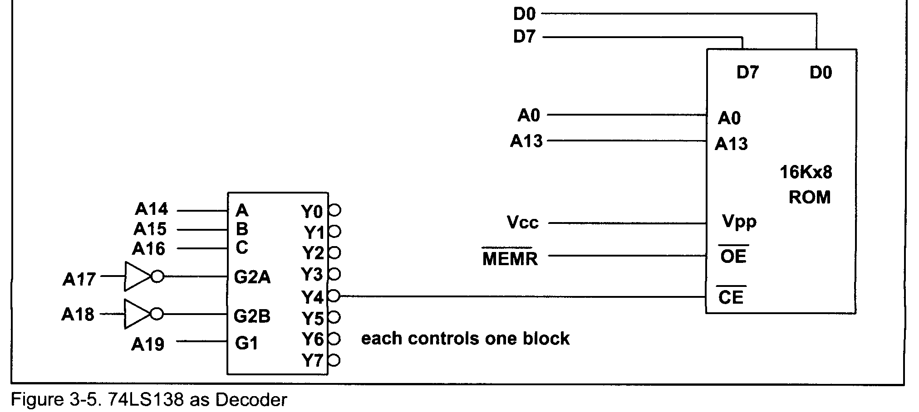

Slide 24
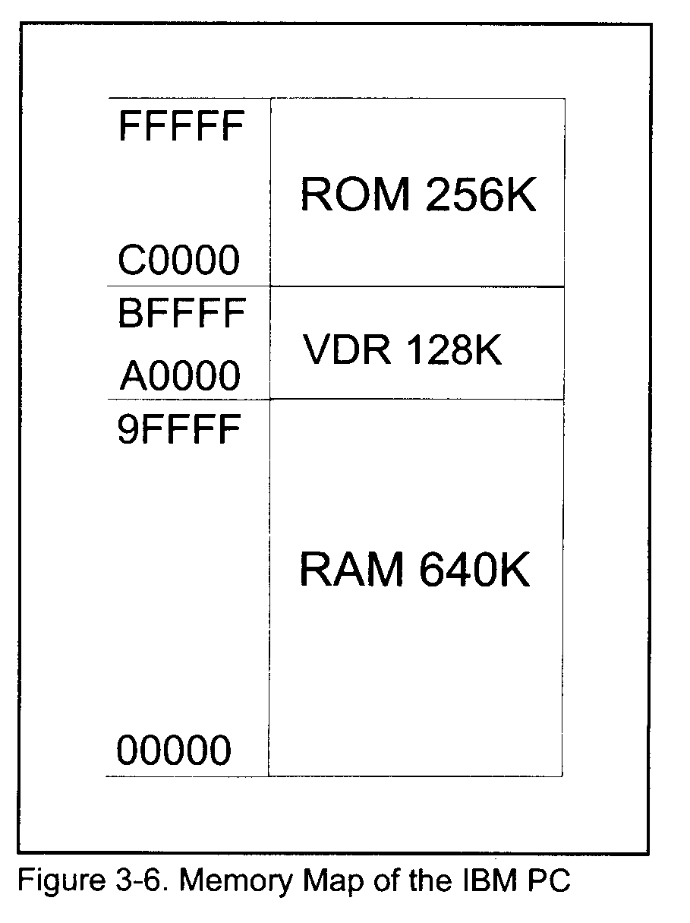
Section 3.2 IBM PC Memory Map
If 80x86 CPUs in real mode provide 20 address bits (A0-A19), the maximum amount of memory that they can handle is 1M.
640K bytes of memory for RAM
128K bytes for video display RAM (VDR)
256K bytes for ROM

Slide 25
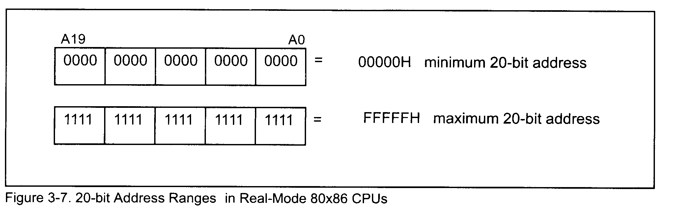
Conventional Memory: 640K of RAM
64K to 256K RAMs on mother board and others are on expansion cards.
Of the 640K bytes of memory, some is used by the MS DOS operating system and the rest of available RAM is used by utilities and application programs.
The detailed memory map of IBM PC is shown in Figure 3-8.

Slide 26
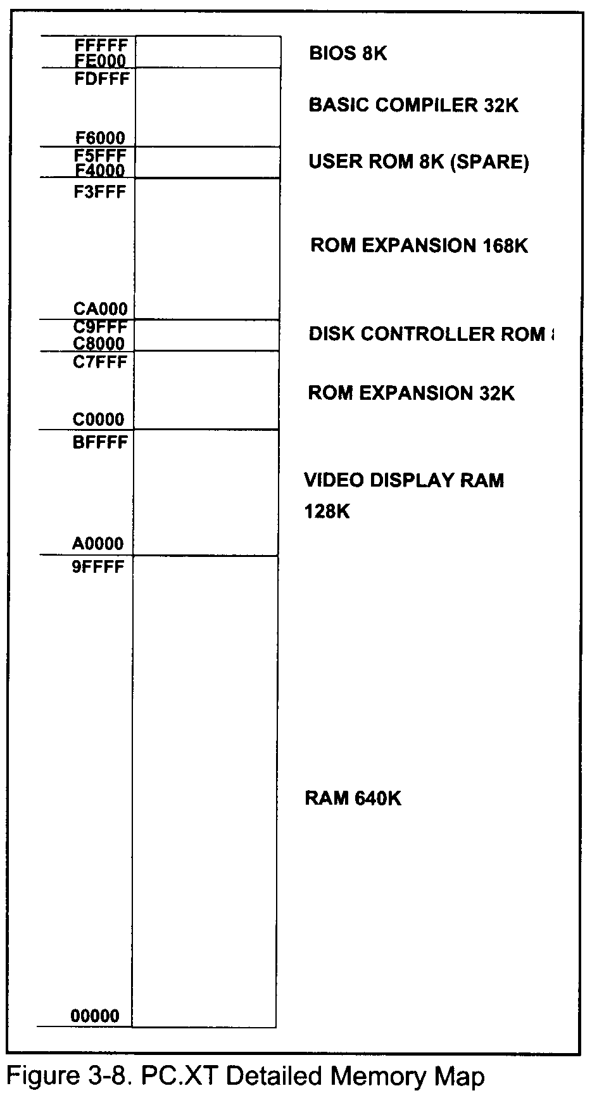

Slide 27
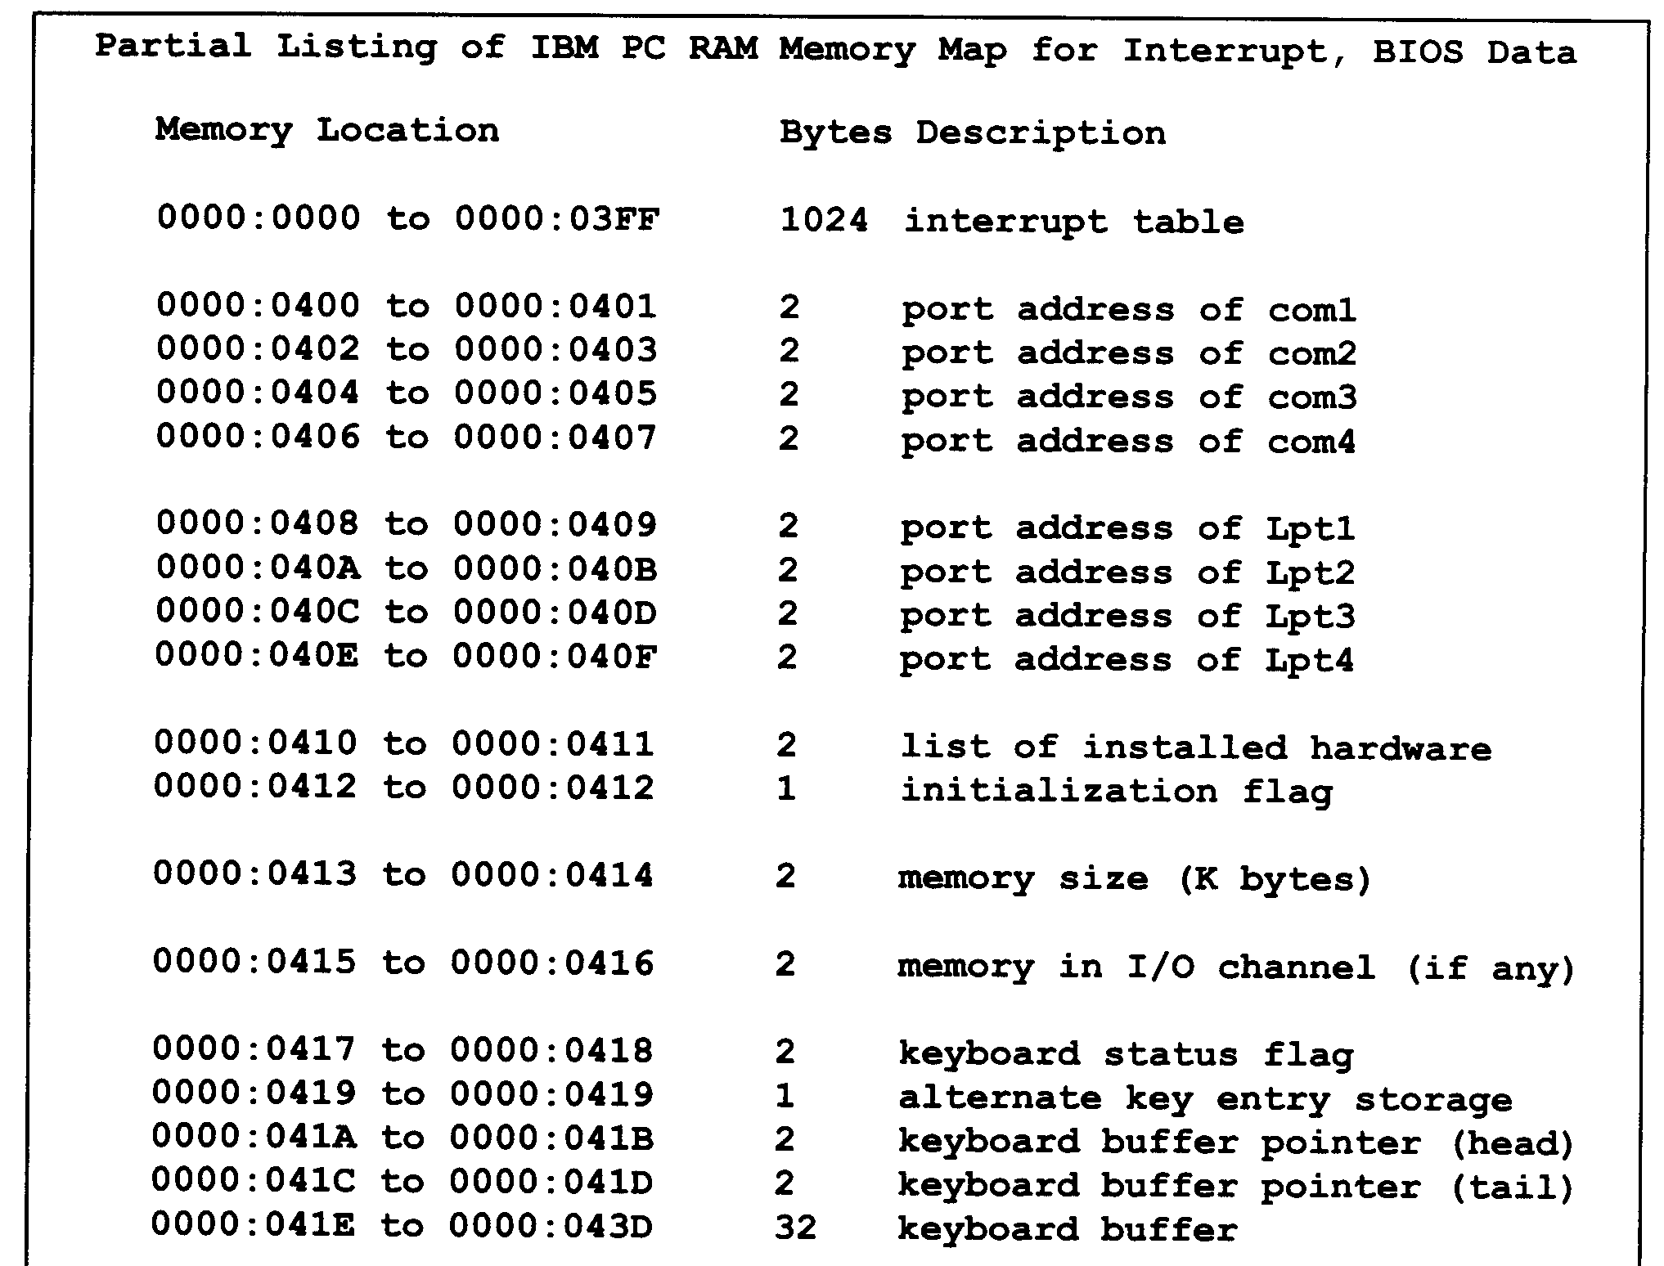

Slide 28
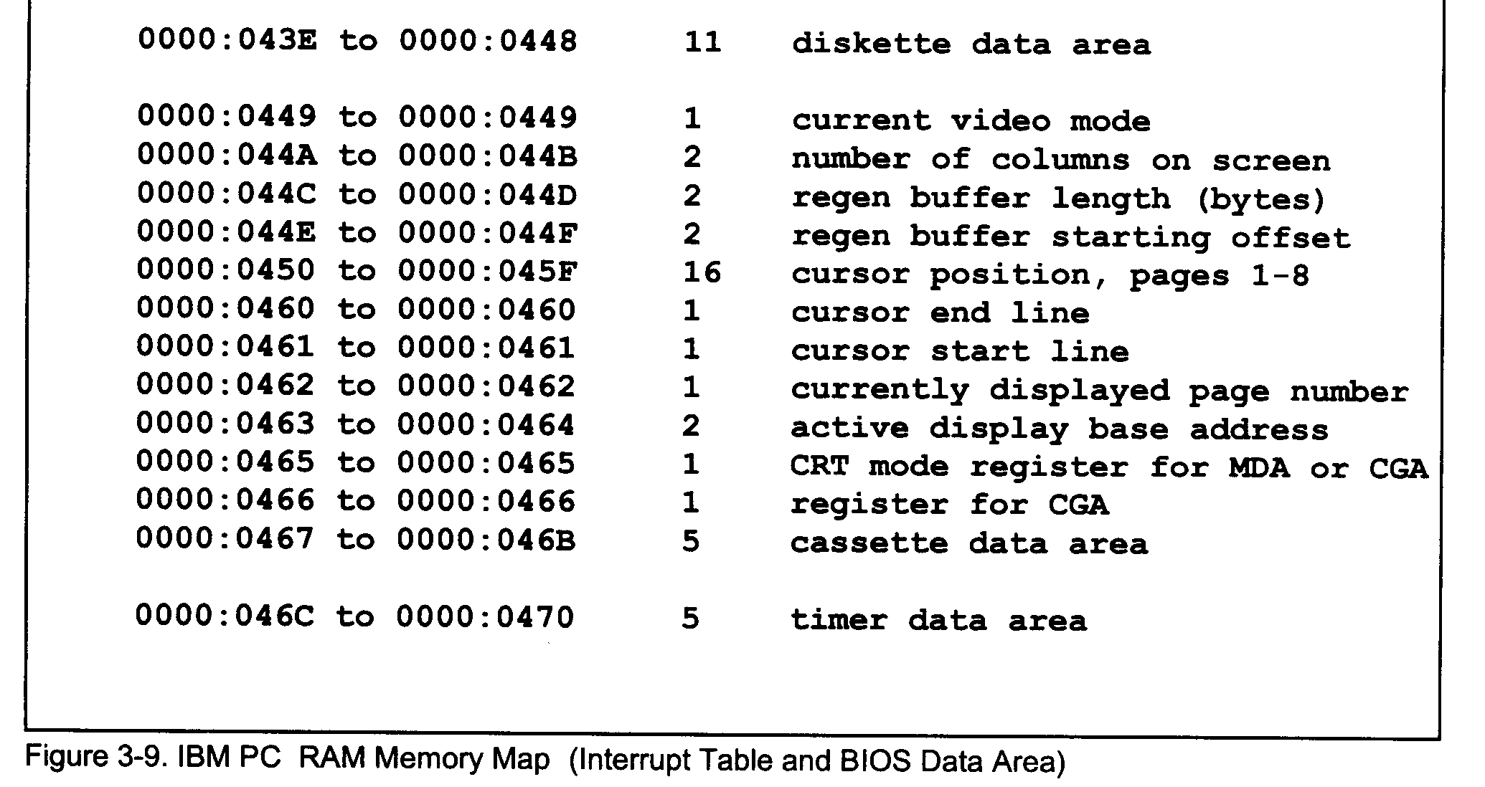

Slide 29
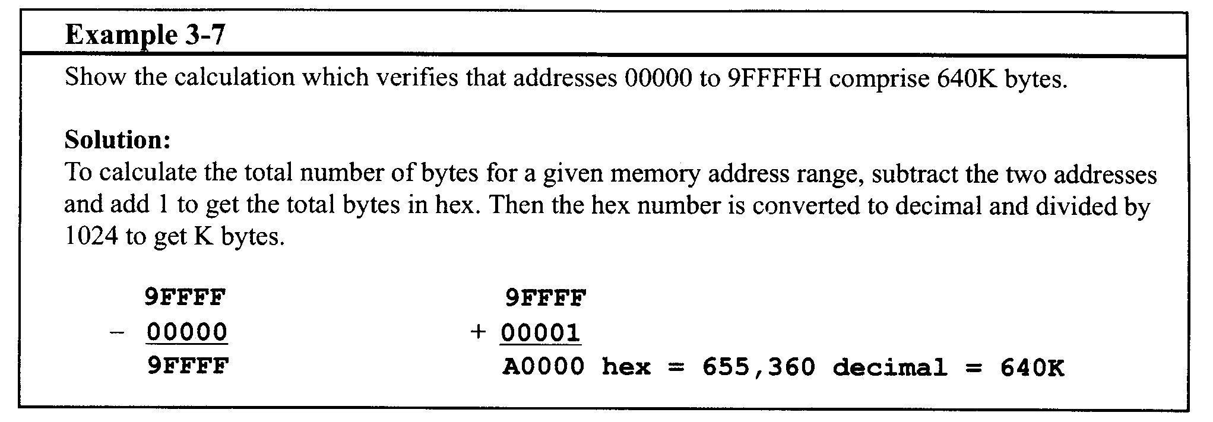

Slide 30
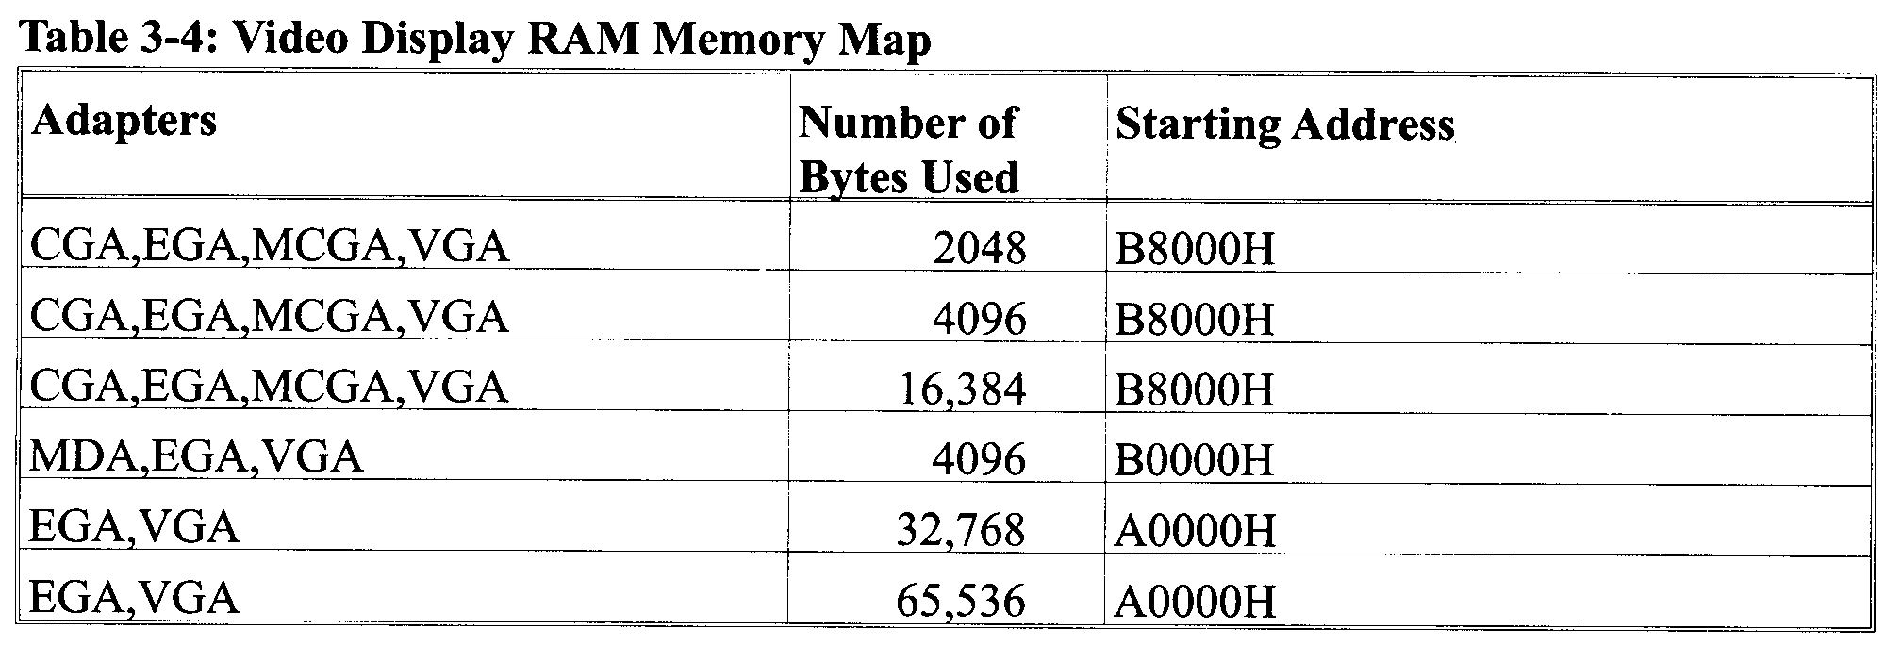
Video Display RAM (VDR) map
To display information on the monitor of the PC, the CPU must first store that information in memory called video display RAM (VDR).
It is the job of the video controller to display it on the screen.

Slide 31
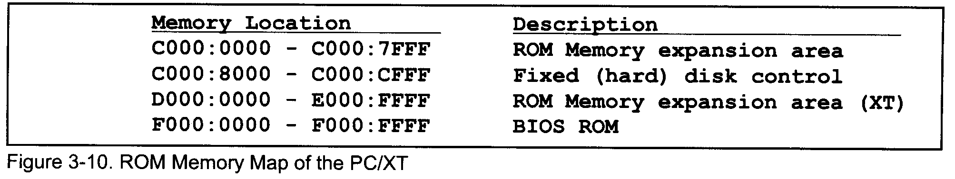
ROM Memory Map
BASIC language compiler ROM
peripheral board ROMs
BIOS ROM
Not all the 256K bytes of memory space allocated for ROM are used.

Slide 32
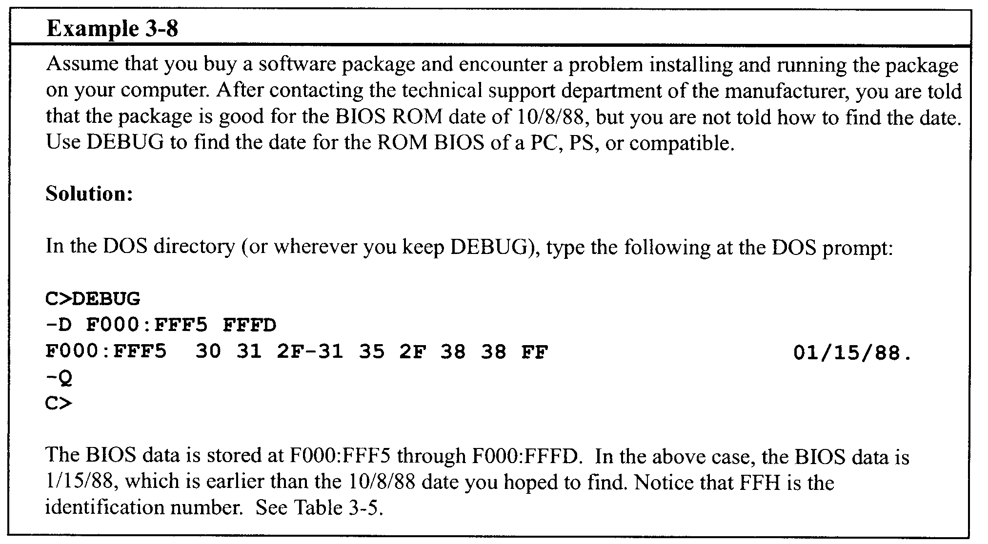
Finding the date of ROM BIOS on Your Computer
F000:FFF5 to F000:FFFD

Slide 33
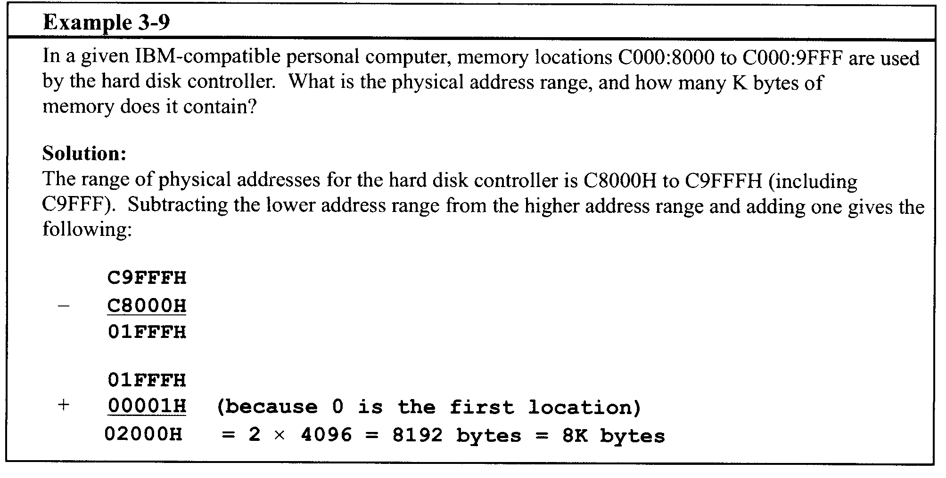

Slide 34
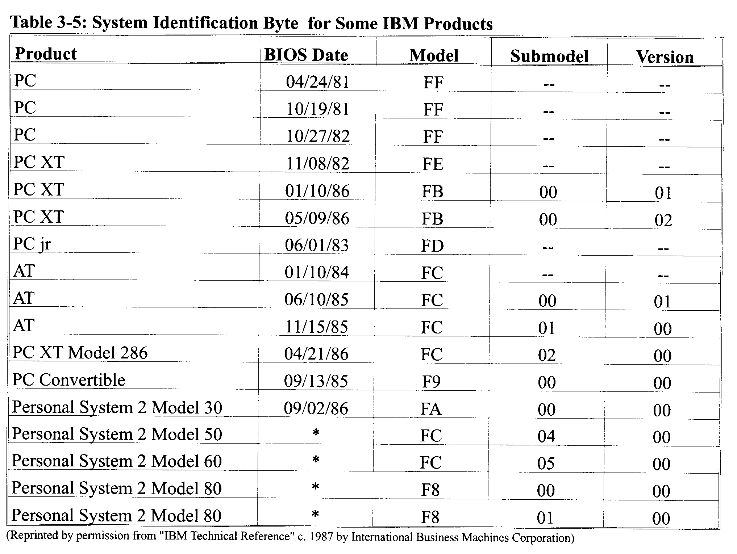

Slide 35
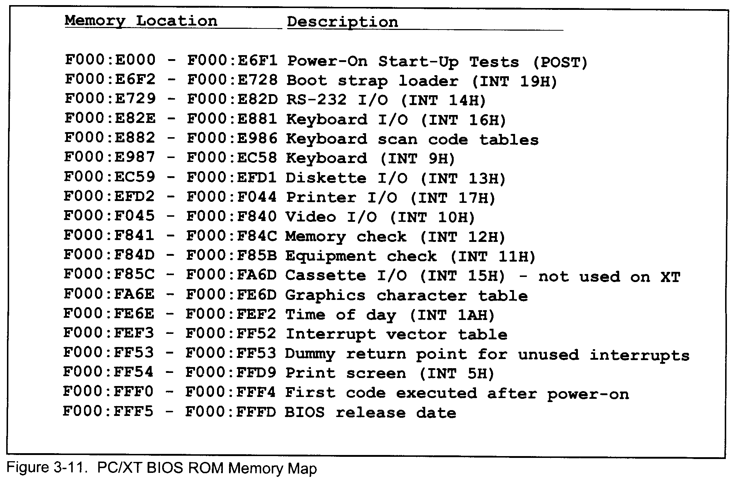

Slide 36
Section 3.3 Memory Interfacing in 8088 IBM PC/XT
Of the 356K bytes from ROM, only F4000H:to FFFFFH is implemented in the PC/XT mother board
— ROM BIOS
— BASIC language ROM
Use 74LS138 to decode
6 8K×8 ROM chips are on mother board.

Slide 37
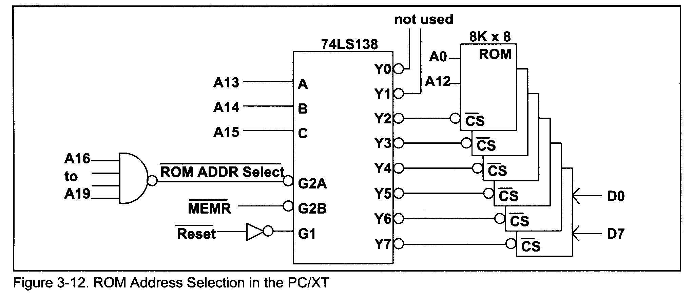
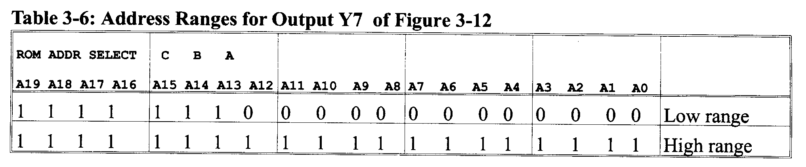

Slide 38
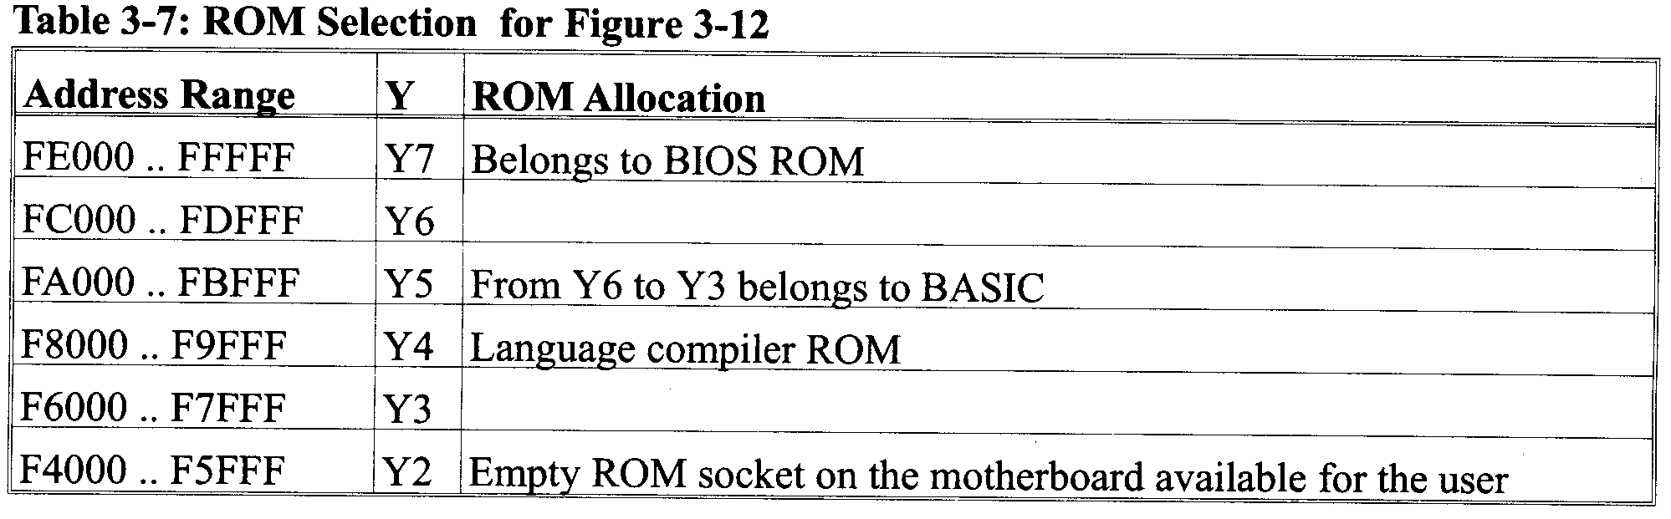
Translating the above binary numbers to hex, the address range FF000H to FFFFFH is assigned to Y7.

Slide 39
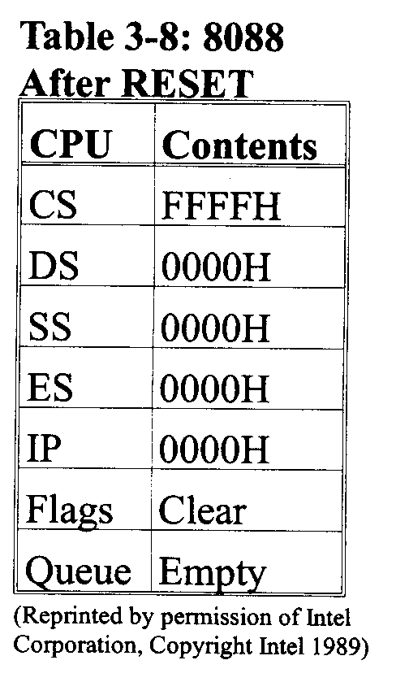
Cold Boot on the IBM PC/XT
Upon RESET the 8088 starts to fetch information from CS:IP of FFFF: 0000, which gives the physical address FFFF0H.
When the computer is RESET, ROM BIOS is the memory that is accessed first by the CPU.
The CPU finds the opcode for the FAR jump, EA, at location FFFF0H and the target address of the JUMP at F000:E05BH

Slide 40
Boot procedures of PC
Check:
CPU
ROM
BIOS
BASIC
RAM
Devices
Hand over to DOS

Slide 41
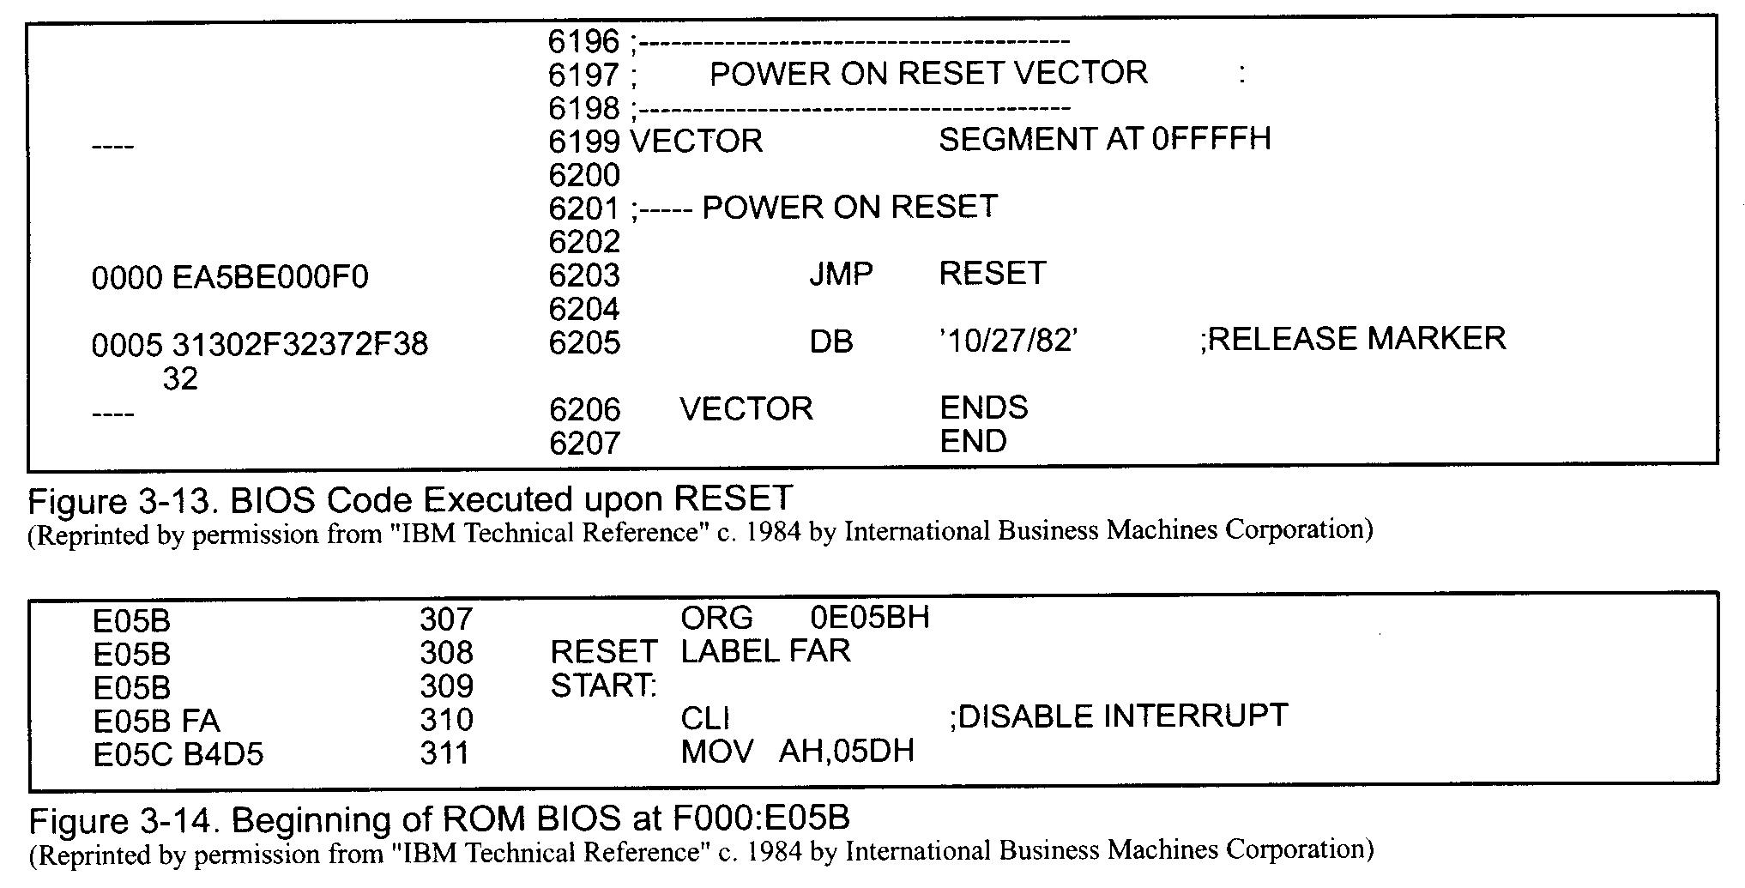

Slide 42
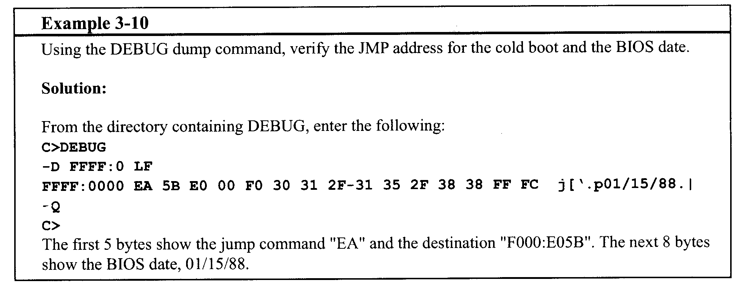

Slide 43
Data Integrity in ROM
To insure the integrity of the ROM’s contents, every PC must perform the checksum calculation to detect any corruption.
The checksum byte is an extra byte that is tagged to the end of a series of bytes of data.
To calculate the checksum byte, do the following steps:
Add the bytes together and drop the carries.
Take the 2’s complement of the total sum, and that is the checksum byte, which becomes the last byte of the series.
To perform the checksum operation, add all the bytes, including the checksum byte.
The result must be zero.

Slide 44
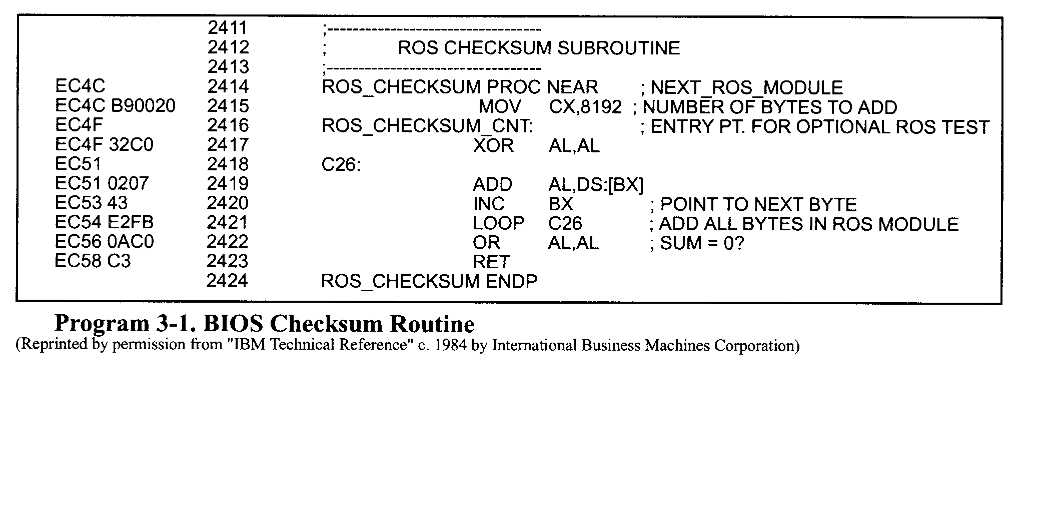
Checksum Program in BIOS

Slide 45
